Slide 1


Apache Pekko
Actor Architecture
Notes:
0:00-0:08: "Hi everyone. Today I'll talk about Apache Pekko, how it uses actors and compare some code with Erlang"

Slide 2








Apache Pekko Framework Features
A powerful toolkit for building concurrent, distributed, and resilient message-driven applications on the JVM.
Actor System:
Clustering:
Distributed
Hierarchical actor
actor systems across
management with
multiple nodes
supervision
Streams:
Reactive
Fault Tolerance:
Built-in
streams for data
supervision strategies
processing
Persistence:
Event
HTTP:
High-performance
sourcing and CQRS
HTTP server and client
patterns
Notes:
0:25-0:35: "Apache Pekko is a powerful toolkit that gives you everything you need to build modern, concurrent applications."
0:35-0:50: "At its core, the Actor System manages actors that communicate through messages, making your app naturally concurrent. Clustering lets you scale across multiple machines."
0:50-1:05: "Pekko Streams handles data processing with backpressure. Built-in fault tolerance means when something breaks, your app keeps running. Event persistence lets you rebuild state from events, and the HTTP module gives you a high-performance web server."

Slide 3







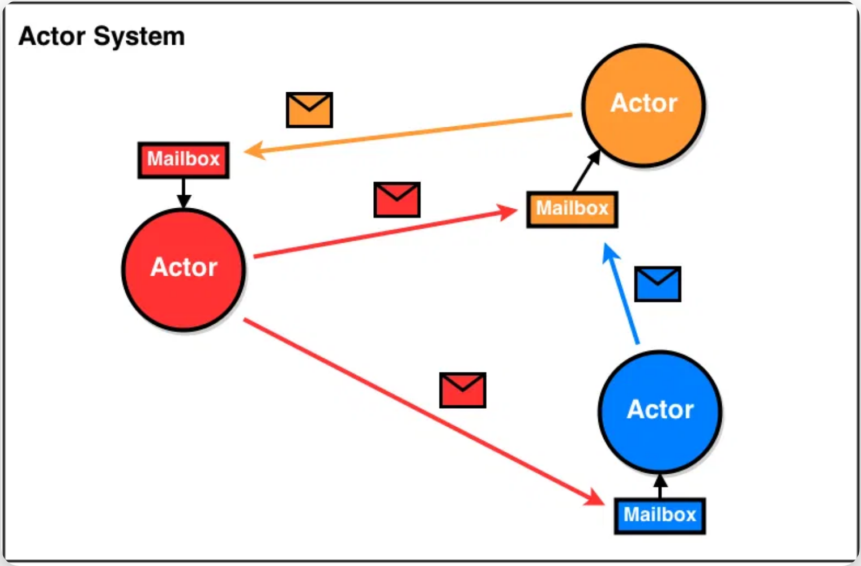

Pekko Actor Architecture & Features
Core Architecture
Advanced Features
Actors are the fundamental building blocks of Pekko's concurrency model.
Pekko provides powerful features for building distributed systems.
ActorSystem:
Hosts multiple actors and manages their
Clustering:
Allows actors to communicate transparently across
lifecycle
multiple nodes
ActorRef:
Reference to an actor, used for sending messages
Supervision:
Hierarchical structure that isolates and recovers
from failures
Mailbox:
Each actor has a mailbox that queues incoming
messages
Event Sourcing:
Support for event-based persistence and CQRS
patterns
Message Patterns:
Support for request-response, pub-sub,
and other patterns
Notes:
1:10-1:20: "Pekko's actor architecture has three main components that work together."
1:20-1:30: "The ActorSystem hosts all your actors and manages their lifecycle. ActorRefs are safe references for sending messages between actors. Each actor has its own mailbox that queues incoming messages."
1:30-1:45: "Some advanced features. Clustering allows actors to work across multiple machines transparently. The supervision hierarchy handles failures automatically - when an actor fails, its supervisor can restart it, resume it, stop it, or escalate the problem."
1:45-1:55: "Event sourcing lets you persist and replay events to rebuild state. Different message patterns like request-response and publish-subscribe give you flexibility in how actors communicate."

Slide 4




Pekko vs Erlang OTP: Code Comparison
Apache Pekko
Erlang OTP
object GreeterDemo {
final case class Greet(whom: String, replyTo: ActorRef[Greeted])
final case class Greeted(whom: String)
def greeter: Behavior[Greet] = Behaviors.receiveMessage[Greet] {
msg =>
println(s"Hello ${msg.whom}!")
msg.replyTo ! Greeted(msg.whom)
Behaviors.same
}
def replier: Behavior[Greeted] = Behaviors.receiveMessage[Greeted] {
msg =>
println(s"Received greeting from ${msg.whom}!")
Behaviors.same
}
def main(args: Array[String]): Unit = {
val system = ActorSystem(Behaviors.setup[Any] { ctx =>
val replierActor = ctx.spawn(replier, "replier")
val greeterActor = ctx.spawn(greeter, "greeter")
greeterActor ! Greet("Roger", replierActor)
Behaviors.empty
}, "HelloSystem")
}
}
-module(erlang_greeter_demo).
-behaviour(gen_server).
-export([init/1, handle_info/2, start/0]).
init(replier) -> {ok, replier};
init(greeter) -> {ok, greeter}.
handle_info({greet, Whom, ReplyPid}, greeter) ->
io:format("Hello ~s!~n", [Whom]),
ReplyPid ! {greeted, Whom},
{noreply, greeter};
handle_info({greeted, Whom}, replier) ->
io:format("Received greeting from ~s!~n", [Whom]),
{noreply, replier}.
start() ->
{ok,ReplierPid } = gen_server:start_link( {local,replier}, ?MODULE, replier, []),
{ok,GreeterPid} = gen_server:start_link( {local,greeter}, ?MODULE, greeter, [ReplierPid]),
GreeterPid ! {greet, "Roger", ReplierPid},
ok.
Key Differences
Type System:
Pekko has strong typing, Erlang is
API Style:
Pekko uses Behavior patterns, Erlang
Runtime:
Pekko runs on JVM, Erlang on BEAM
dynamically typed
uses callbacks
virtual machine
Notes:
2:00-2:10: "Let's look at the Pekko code in detail and see how it compares to Erlang."
2:10-2:30: "In Pekko, we start by defining case classes for our messages. Greet contains the person's name and a replyTo field that tells where to send the response. Greeted is the response message that includes who was greeted."
2:30-2:50: "The GreeterDemo object contains two behavior functions. The greeter function uses Behaviors.receiveMessage to handle Greet messages - it prints hello, sends a Greeted message back using !, and returns Behaviors.same to keep the same behavior."
2:50-3:05: "The replier function handles Greeted messages, prints the confirmation, and also returns Behaviors.same. In the main function, we create an ActorSystem, spawn both actors with names, and send the initial message."
3:05-3:20: "In contrast, Erlang uses the gen_server behavior with callback functions. The init callbacks set up each server's initial state. Unlike Pekko's behavior functions, Erlang uses handle_info callbacks for message processing - both the greet message and the greeted response are handled by handle_info functions."
3:20-3:30: "The start function creates both gen_servers and sends the initial message directly using !. Both languages use ! for async messaging, but Pekko also has ? for synchronous calls."

Slide 5


Apache Pekko: Pros & Cons
Advantages
Challenges
Strong Type Safety
Steep Learning Curve
Catches errors at compile time rather than runtime
Actor model requires different thinking about concurrency
JVM Integration
Debugging Complexity
Access to vast Java/Scala ecosystem and tools
Asynchronous message flow can be harder to trace
Built-in Supervision
Resource Overhead
Ready-to-use fault tolerance strategies
JVM requires more memory than lightweight alternatives
Comprehensive Framework
Testing Challenges
Includes clustering, streams, persistence, and HTTP
Testing concurrent systems requires specialized approaches
Notes:
3:30-3:35: "Some advantages and challenge."
3:35-3:45: "The advantages: strong type safety catches errors before your app runs, JVM integration gives you access to tons of libraries, built-in supervision strategies are ready to use."
3:45-3:55: "The challenges: the actor model requires learning a new way to think, debugging async flows can be tricky, JVM uses more memory than other alternatives, and testing concurrent systems needs specialized approaches."
3:55-4:05: "But overall, the benefits usually outweigh the challenges for most projects."

Slide 6


Key Takeaways
Apache Pekko provides a robust implementation of the Actor Model for building concurrent, distributed systems
Pekko's Actor architecture offers state isolation, asynchronous communication, and supervision hierarchy
Pekko offers strong type safety and JVM integration, facilitating the development of resilient systems
Apache Pekko: Building resilient, message-driven applications
Notes:
4:05-4:15: "Let me highlight the three core principles that make Pekko's actor architecture powerful."
4:15-4:25: "First, state isolation - each actor owns its data completely, so there's no shared state to cause conflicts. Second, asynchronous communication - actors send messages without blocking, keeping your system responsive."
4:25-4:35: "Third, supervision hierarchy - parent actors automatically manage child actor failures, creating self-healing systems. These three principles together solve the hardest problems in concurrent programming."

Slide 7


References & Further Reading
Actor Model History
Erlang OTP Resources
Carl Hewitt et al. (1973) - "A Universal Modular ACTOR Formalism for AI"
Erlang/OTP - gen_server Behavior
Documentation for Erlang's gen_server behavior
The original paper introducing the Actor Model
Learn You Some Erlang - What is OTP?
Apache Pekko Documentation
Comprehensive guide to understanding Erlang OTP
Apache Pekko - Actor Reference Documentation
Official documentation for Pekko's Actor implementation
Apache Pekko - Getting Started Guide
Tutorial for building your first Pekko application
Notes:
4:35-4:45: "If you want to learn more, check these links."
4:45-4:55: "The Pekko docs have guides and examples. The Erlang resources show the OTP approach."
4:55-5:00: "Thanks for listening. Any questions about Apache Pekko or the actor model?"

